Slide 1
Requirements in the context of System Engineering
By: Fariha Shaikh

Slide 2
System Engineering & Its Requirements
Functional and Non-Functional Requirements
Factors Of SE:

Slide 3
System Engineering:
System: A set of things working together as parts of a mechanism or an interconnecting network.
Systems engineering, technique of using knowledge from various branches of engineering and science to introduce technological innovations into the planning and development stages of a system.
System engineering (or systems engineering) is an interdisciplinary field of engineering that focuses on designing, integrating, and managing complex systems throughout their life cycle.

Slide 4
A system can be defined as a combination of different components, such as hardware, software, human factors, processes, and information, that work together to achieve a specific goal or solve a problem.
The most important aspect of systems engineering is its role in developing new technological possibilities with the specific aim of implementing them as quickly as economic and technical constraints allow.
The systems with which a systems engineer is concerned are first of all man-made. Second, they are large and complex.

Slide 5
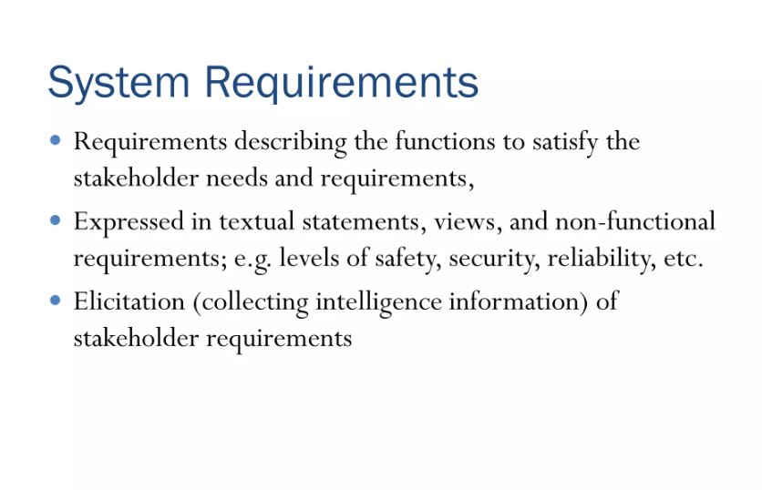

Slide 6
System requirements define the technical features of the software system, including its architecture, hardware needs, software components, and interfaces. System requirements are usually described in technical language and serve as a foundation for system design.
According to ISO:
“ A Requirements is a statement that identifies a product or processes operational, functional or design characteristic or constraints which is unambiguous, testable, or measurable and necessary for product or process acceptability.”

Slide 7
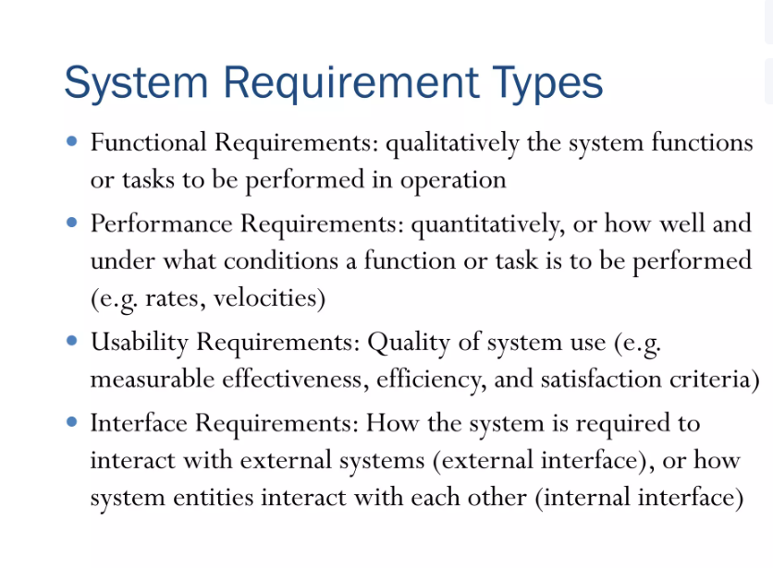

Slide 8
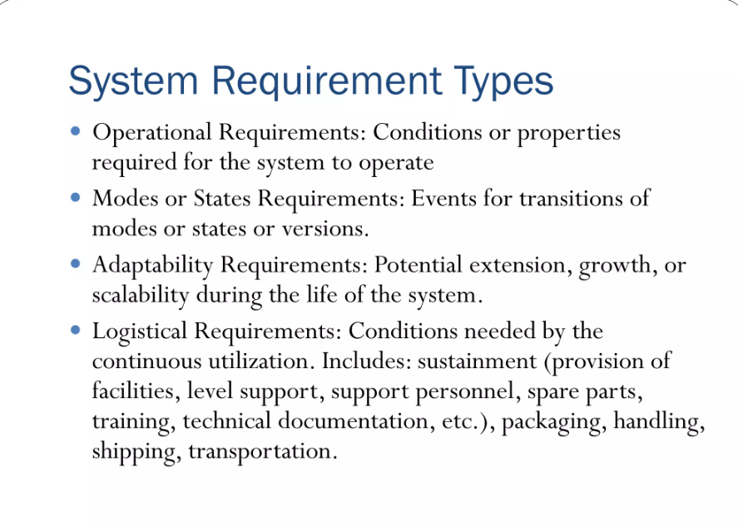

Slide 9
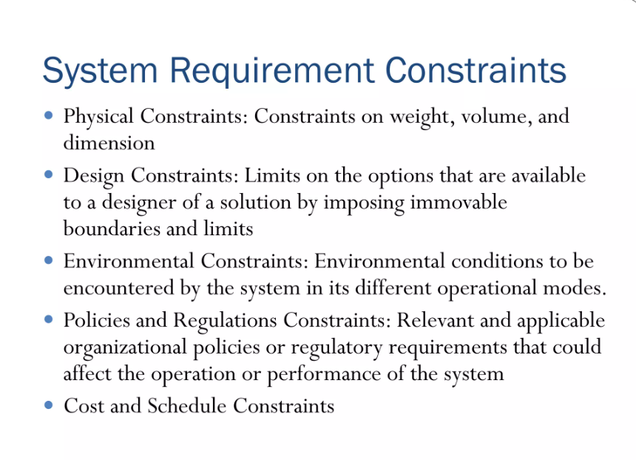

Slide 10
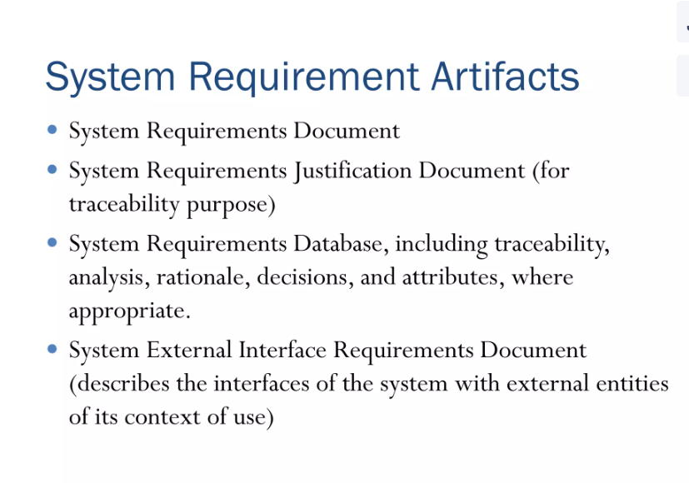

Slide 11
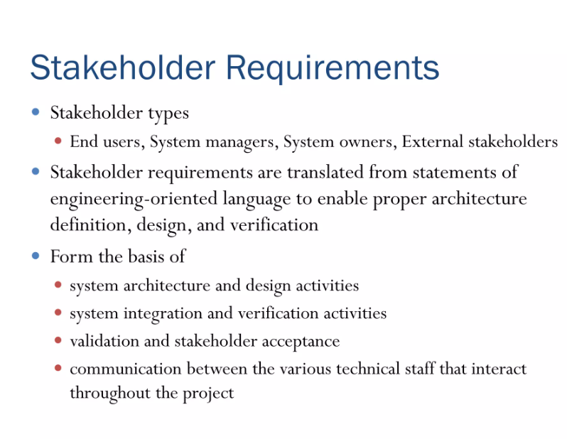

Slide 12
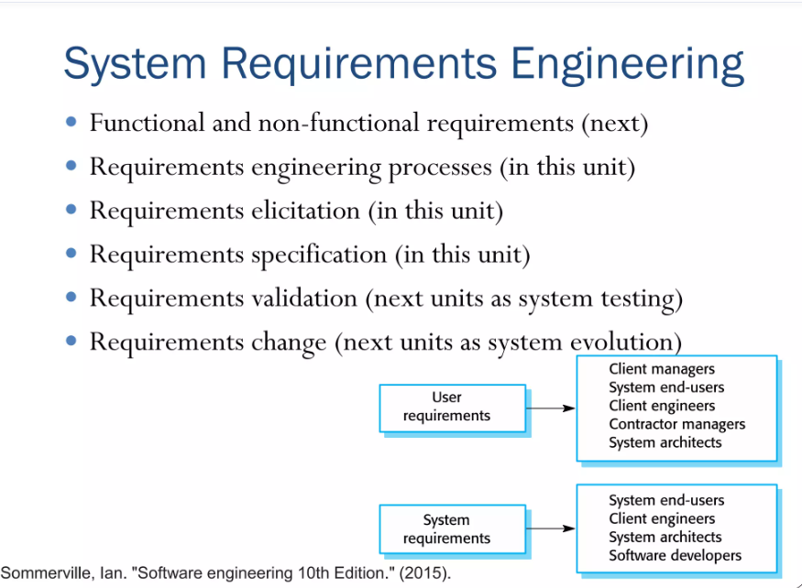

Slide 13
Functional & Non-Functional Requirements

Slide 14
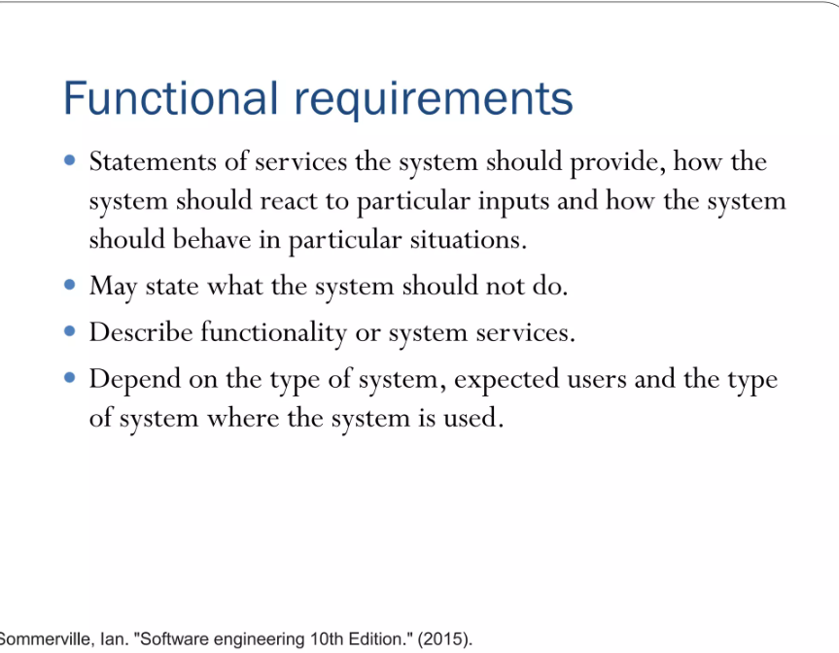

Slide 15
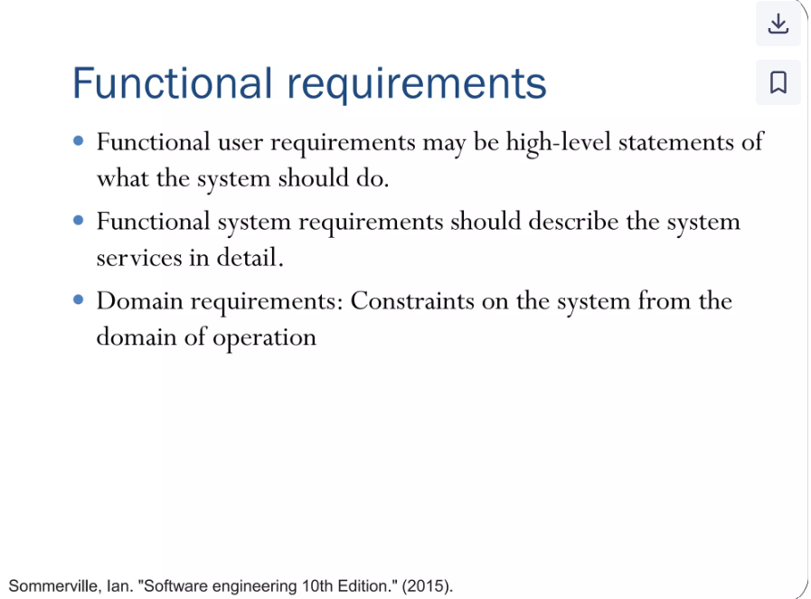

Slide 16
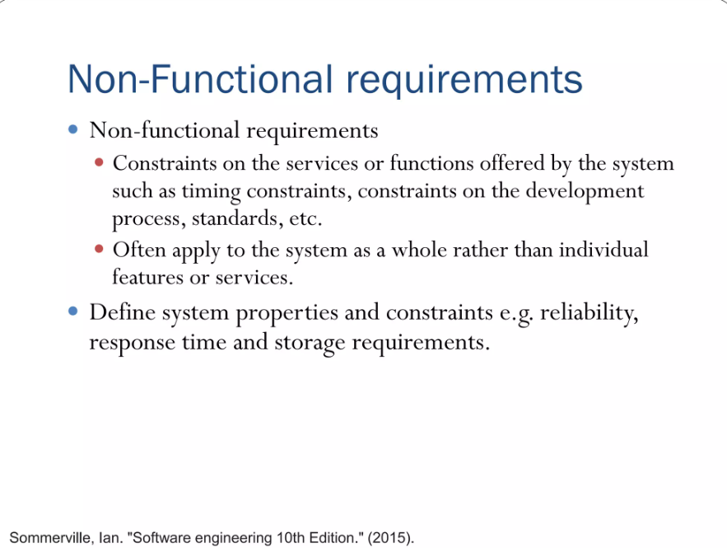

Slide 17
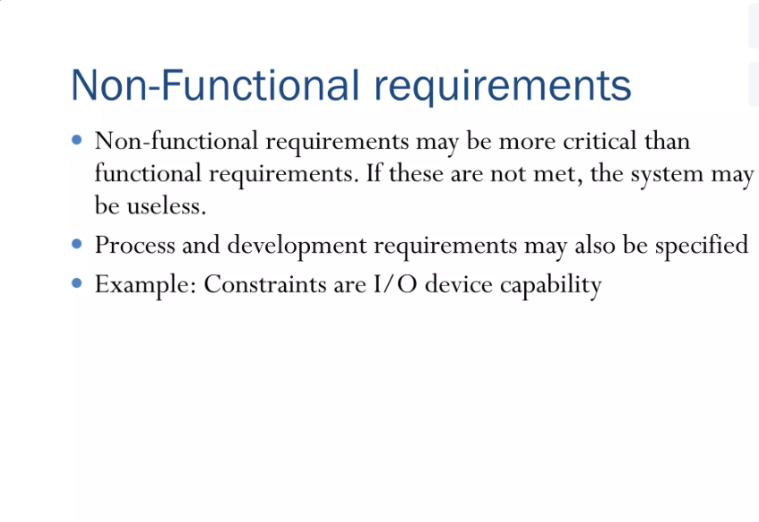

Slide 18
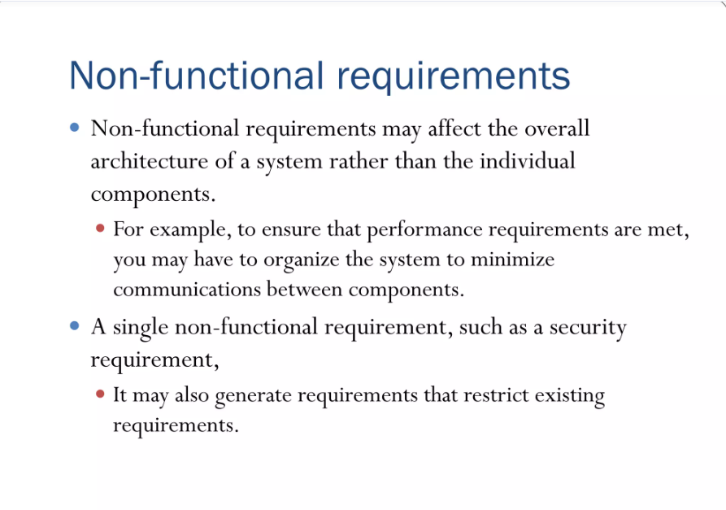

Slide 19
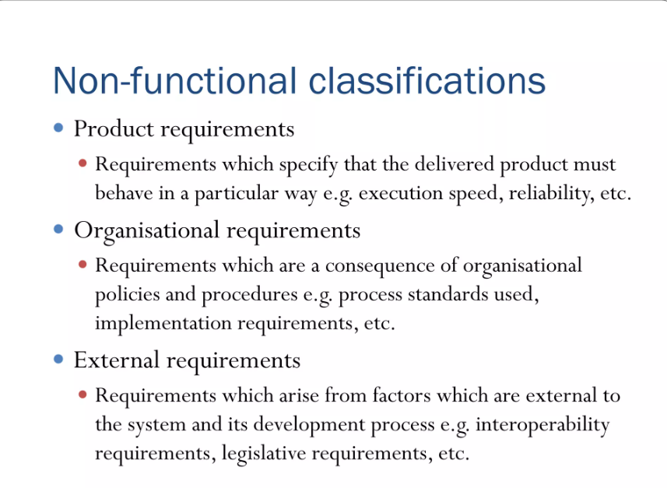

Slide 20
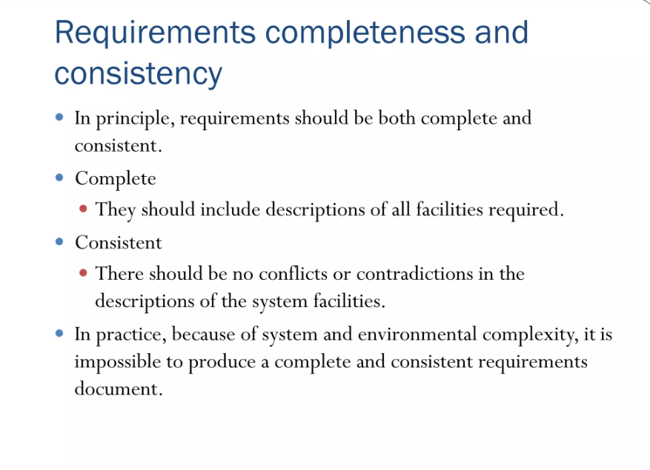

Slide 21
Important Factors Of System Engineering

Slide 22
Factors Of SE:
System engineering involves a variety of factors that influence the successful design, development, and operation of complex systems. These factors encompass technical, organizational, and human aspects that must be considered throughout the system's lifecycle to ensure it meets its objectives effectively.
Stakeholder Needs and Requirements: Identification of Stakeholders: Understanding who the stakeholders are (e.g., customers, users, operators, management) and what their needs and expectations are.
Requirements Gathering: Collecting and documenting both functional (what the system must do) and non-functional requirements (performance, usability, security, etc.).

Slide 23
Alignment with Business Goals: Ensuring the system aligns with the organization's overall strategy and objectives.
2) System Complexity:
System Scope: Defining the boundaries of the system and understanding how complex the system is in terms of its components, interactions, and dependencies.
Subsystem Integration: Managing the interconnection and interaction of various subsystems (hardware, software, processes, human elements) to form a coherent whole.
Emergent Properties: Accounting for system behaviors that arise from the interaction of subsystems and are not obvious when considering each part in isolation.

Slide 24
3) Lifecycle Considerations:
Development Lifecycle: Managing the entire system development process, from concept through design, implementation, testing, deployment, maintenance, and retirement.
Sustainability and Maintenance: Ensuring that the system can be maintained, upgraded, and supported over time.
Disposal or Retirement: Planning for the end-of-life of the system and the safe decommissioning or replacement of system components.

Slide 25
4) Interdisciplinary Integration:
Cross-Disciplinary Collaboration: Coordinating efforts between different engineering disciplines (e.g., mechanical, electrical, software) and non-technical fields (e.g., management, human factors).
System Architecting: Designing a high-level structure that integrates various components and ensures they work together harmoniously.

Slide 26
5) System Requirements Management:
Requirements Traceability: Ensuring that all system requirements are clearly traced back to stakeholder needs and linked to specific components of the system.
Change Management: Handling changes in system requirements during development and ensuring they are properly incorporated without compromising system integrity.
Prioritization: Balancing conflicting requirements and prioritizing them based on importance, cost, and feasibility.

Slide 27
6) Risk Management:
Risk Identification: Recognizing potential risks (technical, operational, financial, etc.) early in the system life cycle.
Risk Mitigation: Implementing strategies to reduce the likelihood and impact of risks (e.g., through redundancy, fail-safes, and backup systems).
Contingency Planning: Developing plans to handle failures, disruptions, or unforeseen issues that may arise during system operation.

Slide 28
7) System Performance and Optimization:
Performance Requirements: Ensuring the system meets specific performance metrics (e.g., speed, efficiency, throughput, reliability).
Optimization: Balancing factors such as cost, time, and resource constraints to optimize system performance while maintaining quality.
Trade-Off Analysis: Conducting trade-off studies to balance competing priorities (e.g., cost vs. performance, flexibility vs. complexity).

Slide 29
8) Verification and Validation (V&V):
Verification: Ensuring that the system is built according to the specified requirements and design.
Validation: Confirming that the system meets the intended needs and performs its desired functions in the real-world environment.
Testing and Evaluation: Performing simulations, modeling, and real-world testing to ensure the system works as intended under various conditions.

Slide 30
9) Human Factors and Usability:
User-Centered Design: Incorporating user needs and ergonomics into the system to ensure it is easy to use, safe, and effective.
Training and Support: Providing adequate training and support to users, operators, and maintenance personnel to ensure smooth system operation.
Human-System Integration: Ensuring that human factors are considered in the design, operation, and interaction of the system to minimize user errors and maximize efficiency.

Slide 31
10) Regulatory and Compliance:
Standards and Regulations: Ensuring that the system complies with industry standards, legal requirements, and regulatory guidelines (e.g., safety, environmental, privacy).
Certification: Obtaining necessary certifications and approvals for system operation (e.g., for medical devices, aerospace systems, or defense applications).

Slide 32
11) Cost and Schedule Management:
Cost Estimation: Accurately estimating the cost of system development, implementation, and maintenance, and managing budgets.
Resource Allocation: Efficiently allocating resources (human, financial, technological) throughout the system lifecycle.
Schedule Management: Ensuring that the system is developed and deployed within the planned timeframe, while also managing delays and unforeseen challenges.

Slide 33
12) Technology and Innovation:
Emerging Technologies: Identifying and incorporating new and evolving technologies that can enhance system performance, efficiency, and capabilities.
Scalability and Flexibility: Designing systems that can adapt to future technological advancements, growth, or changing requirements.
13) Security and Reliability:
Security Requirements: Ensuring that the system is secure from cyber attacks, unauthorized access, and other security threats.
Reliability and Redundancy: Designing the system to be reliable, with backup systems or redundancy to handle failures and minimize downtime.
Fault Tolerance: Ensuring the system can continue to operate under fault conditions or recover gracefully from disruptions.

Slide 34
14. System Architecture and Design:
Modularity: Designing the system in modular components (independent parts of a system that can be combined, replaced, or reused easily) to facilitate easier integration, testing, and future upgrades.
Interface Management: Clearly defining how different system components interact and ensuring compatibility between them.
Open vs. Closed Systems: Determining whether the system will be open for future integration with other systems or remain self-contained.
15. Environmental and Ethical Considerations:
Sustainability: Ensuring the system design considers environmental impacts, including energy consumption, waste reduction, and ecological balance.
Ethical Implications: Considering the ethical aspects of the system’s development and use, especially in fields like AI, automation, and healthcare.

Slide 35
16. Communication and Coordination:
Cross-Team Collaboration: Facilitating clear communication among various teams (engineers, project managers, stakeholders) to ensure smooth coordination.
Documentation: Maintaining clear, up-to-date documentation throughout the system’s lifecycle to ensure knowledge sharing and traceability.

